Slide 1



Workshop
“Experiences in implementing pan-European services using national INSPIRE services “
Conclusion
23 October 2019

Slide 2
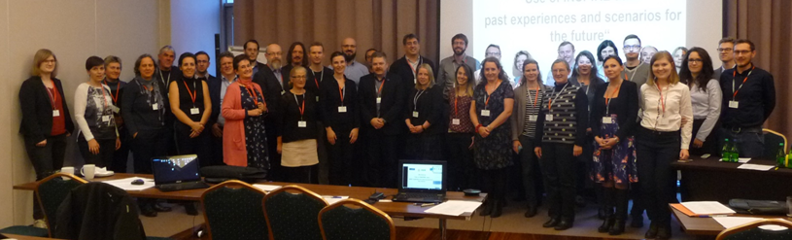
Use of INSPIRE data
INSPIRE KEN Workshop held on November 2018
Rationale:
  INSPIRE benefits widely recognised for supporting national and European SDI (discovery, coordination, …)
  But limited use of INSPIRE (interoperable) data

Slide 3
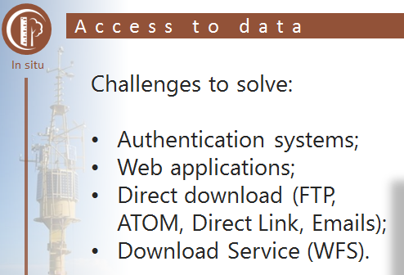

Barriers: easy access to data
Variety and limits of download services
“Most of our requirements cannot be met together in a distributed SDI infrastructure : Integration, edge-matching, generalisation »
ELF
EEA integration test on theme AU
CRD
Eurostat not so much interested by the INSPIRE puzzle

Slide 4
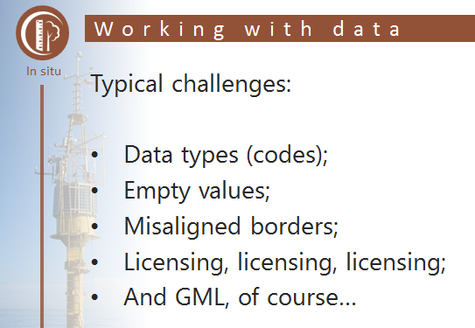
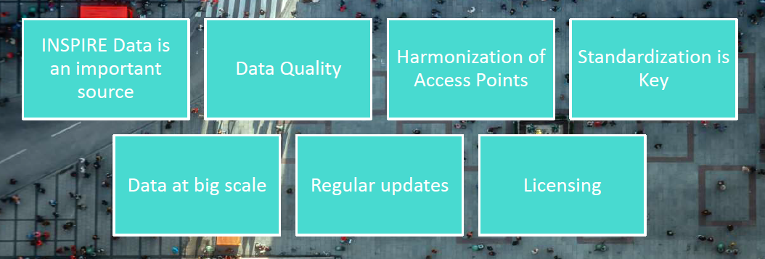
Barriers: legal access (licensing)
Is it easy to understand access conditions to INSPIRE data?
  Not enough according to users
Open ELS
From EEA presentation
From HERE presentation

Slide 5
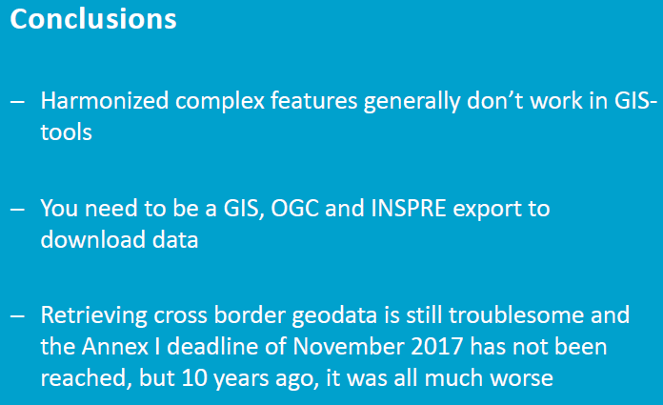
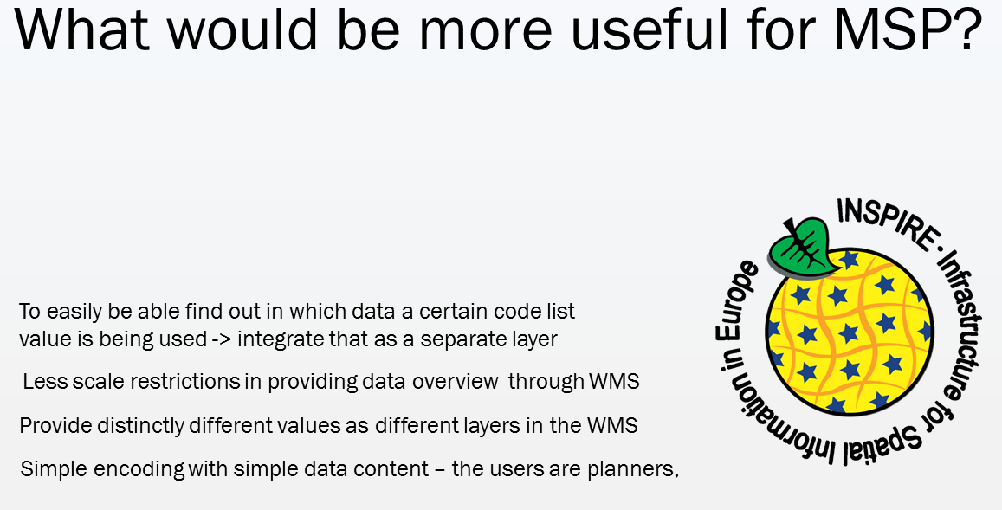
Barriers: difficult use
Complex INSPIRE data models not easily usable in GIS
Not everyone familiar with GML
  WMS + INSPIRE portrayal rules already useful
Use of INSPIRE data for X-border accessibility assessment
CRD
Use of INSPIRE data for Marine Spatial Planning

Slide 6
Main learnings from EuroGeographics initiatives
Benefits : attempts to face the main issues met by users when willing to exploit INSPIRE data
But some disappointment
  Main potential pan-European user (European Commission) has shown
    Limited interest for INSPIRE data
    Limited support (funding)

Slide 7
Conclusions
We should not forget the positive side of INSPIRE
Next INSPIRE KEN event
  Webinar about “INSPIRE by inspiration and not by obligation”
  Date not yet fixed (end 2019)

Slide 8
Conclusions
INSPIRE often considered as first step towards interoperability
Workshop objective was to share EuroGeographics experience and to help on the next steps
  Useful input today
  Hopefully, discussion to be continued in Dubrovnik …

